Slide 1

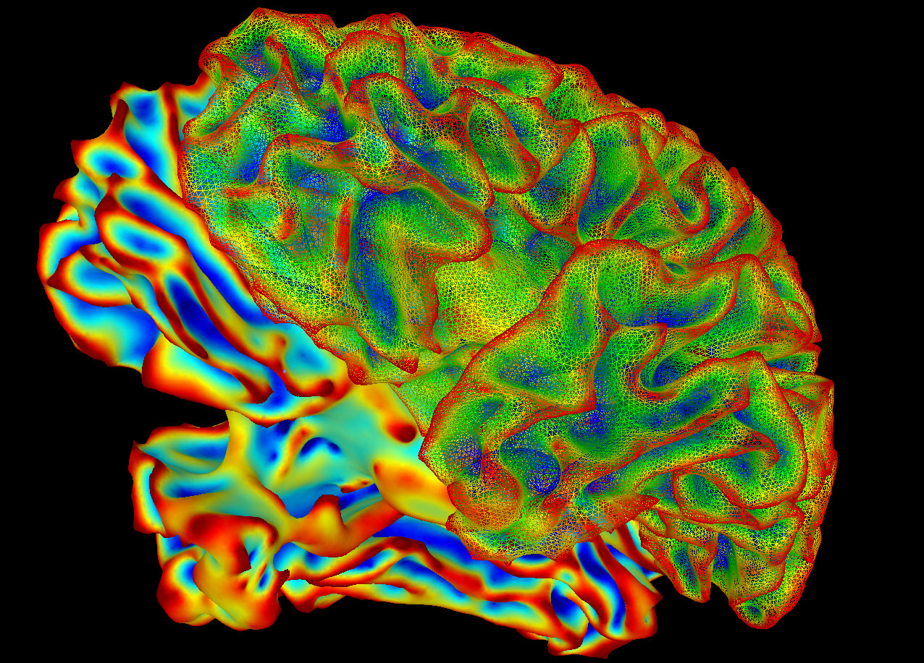
Understanding Mental Disorder Diagnosis for US Service Members
Authors: Yagmur Yavuz Ozdemir and Eyoel Berhane

Slide 2
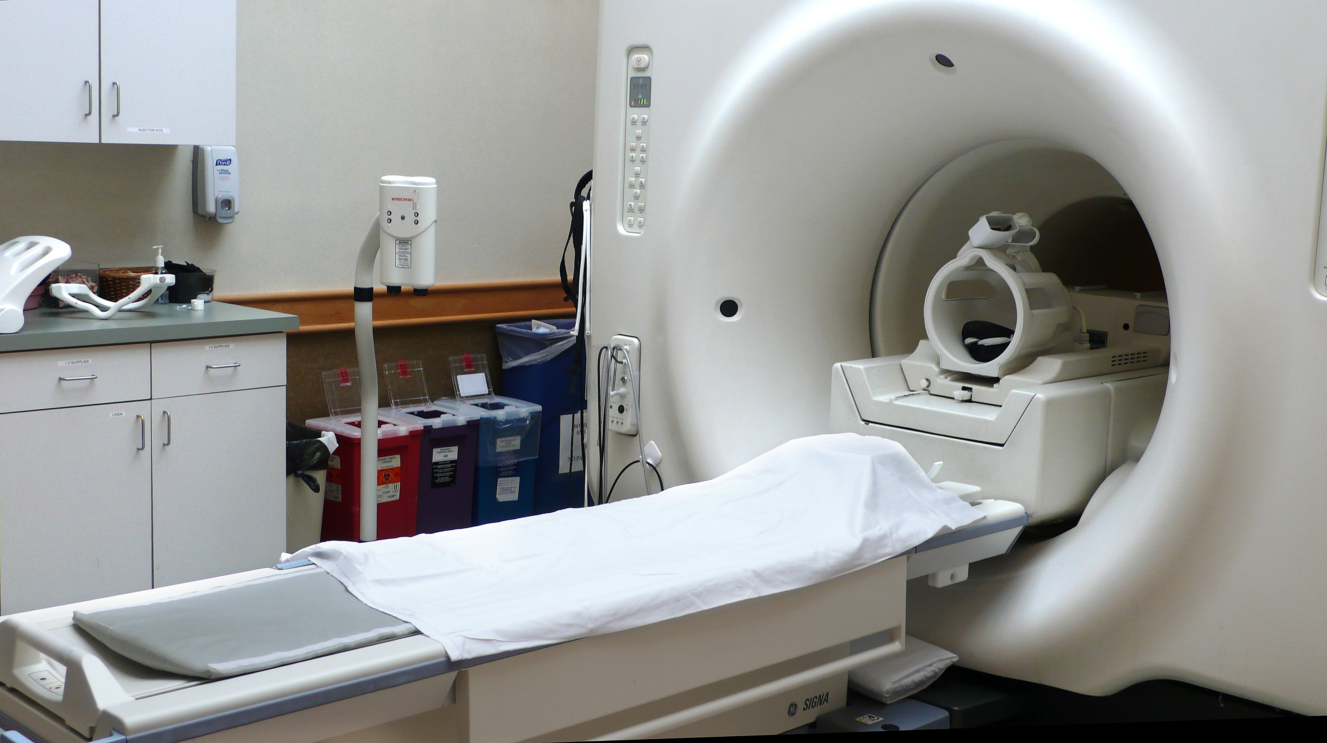
PROJECT BACKGROUND
Doctors diagnose patients for a litany of conditions for a living, and often physical ones are clearcut for them when the symptoms fall in well-organized categories.
Diagnosing mental disorders is often a difficult process even with a mix of classifying certain symptoms and behaviors, for the affects of certain conditions linger longer and often unseen methods.
MRIs and other tools are common methods for collecting information on the brain, such as brain waves and neural activity, in order to understand such conditions better in a physical manner. Often traumatic conditions on the brain (or affecting it) are profound yet not easy to observe directly.

Slide 3
DATASET BACKGROUND
Signals between two brain regions are obtained from brain images (scanned in Auburn University – MRI Center). 139 active-duty male US Army soldiers were recruited for this study from Fort Benning, GA, and Fort Rucker, AL, USA. All groups were matched for age, race, education, and deployment history.
There are 677 variables that are all numeric and between -1 and 1 since they represent correlations between the signals of 2 brain regions.

Slide 4
PROJECT PRIORITY
Classification techniques: to automatize the detection of these mental health problems using brain signals.
Accuracy
Sensitivity
Specificity
Feature importance: since this is a high-dimensional data, we would like to extract the important brain regions related to PTSD
Random forest
Lasso logistic

Slide 5
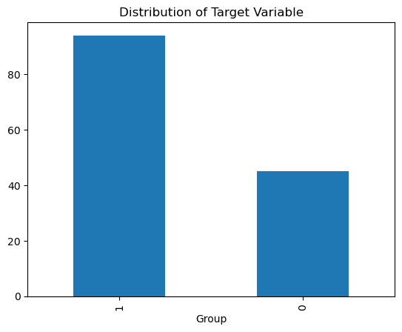
Dataset Organization
We decided that since the symptoms between PTSD and PCS patients are often similar, we decided to classify the dataset as a binary variable between control (0) and the affected (1) groups.
We split the dataset into an 80/20 training vs validation set for whichever model we would choose.

Slide 6
FEATURE IMPORTANCE
Random Forest :
-The minimum number of samples required to be at a leaf node = 1
- The minimum number of samples required to split an internal node = 5
-The number of trees in the ensemble= 50
-Validation Accuracy = 0.857
Lasso Logistic:
-5-fold CV
-Validation accuracy = 0.949

Slide 7
FEATURE IMPORTANCE
The following table shows the brain regions of the selected variables by both random forest model and lasso logistic model.
Brain region | How many times it is selected
Frontal | 26
Temporal | 17
Occipital | 7
Cingulum | 5
Lingual | 5

Slide 8
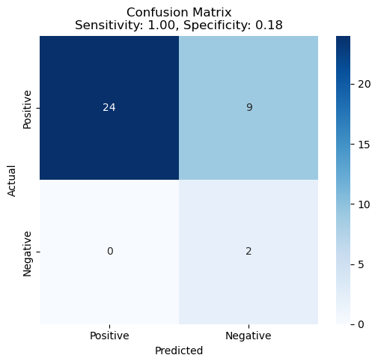
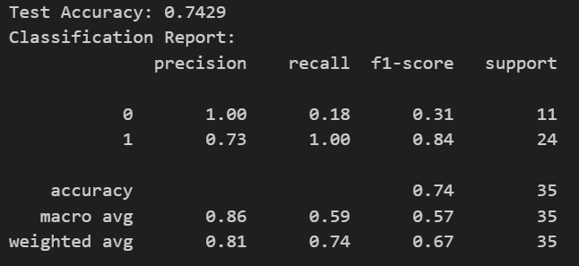
FINAL MODEL
Since the validation accuracy is higher in Lasso model, we select if as our final model. The following shows the accuracy matrix.

Slide 9
CONCLUSION
We used a high dimensional brain image data to automate the detection of PTSD and to extract the important brain regions.
Since the aim is to detect, we aggregate the PCS and PTSD.
For feature importance purposes, random forest and lasso logistic are employed.
The temporal and the frontal lobes are found to be the most important features as well as occipital, cingulum and lingual which have been reported to have alterations in PTSD before (Yin et al. 2012; Zhang et al. 2016; Liu et al. 2015)
Lasso logistic has been selected as the final model with a 74% test accuracy.
The model has the highest sensitivity which shows perfect detection of the positive cases.

Slide 10
References
Lanka, Pradyumna, et al. "Supervised machine learning for diagnostic classification from large-scale neuroimaging datasets." Brain imaging and behavior 14 (2020): 2378-2416.
Yin, Y., Jin, C., Eyler, L., Jin, H., Hu, X., Duan, L., et al. (2012). Altered regional homogeneity in post-traumatic stress disorder: a restingstate functional magnetic resonance imaging study. Neuroscience Bulletin, 28(5), 541–549.
Zhang, Q., Wu, Q., Zhu, H., He, L., Huang, H., Zhang, J., & Zhang, W. (2016). Multimodal MRI-based classification of trauma survivors with and without post-traumatic stress disorder. Frontiers in Neuroscience, 10, 292.
Liu, F., Xie, B., Wang, Y., Guo, W., Fouche, J.-P., Long, Z., Wang, W., Chen, H., Li, M., Duan, X., Zhang, J., Qiu, M., & Chen, H. (2015). Characterization of post-traumatic stress disorder using resting-state fMRI with a multi-level parametric classification approach. Brain Topography, 28, 221–237.

